Slide 1

Personal Finance app

Slide 2

presentation
INTRODUCTION
backend
frontend
Tech demo
Challenges faced
Lessons learned

Slide 3

introduction
Efficient account management

Slide 4

backend

Slide 5

technologies
Java 22
Spring Boot 3.3.1
Spring Data JPA
Spring MVC
PostgreSQL

Slide 6
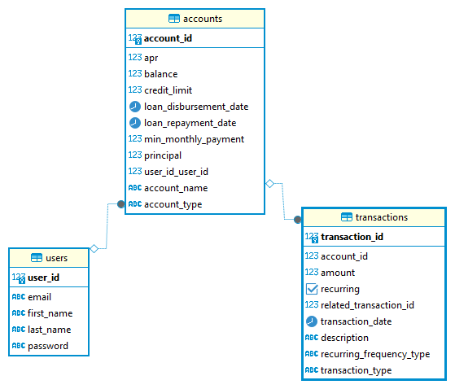

Slide 7
Frontend

Slide 8

Technologies
React 18.3.1
React Bootstrap 2.10.4
Axios 1.7.2
React Router DOM 6.24.1

Slide 9
Tech demo
Personal finance app

Slide 10
Challenges faced
Lost team members
Git merging issues / version control
NavBar state refresh / update issues
Transactions not updating account balance
Configuring Spring default schema when multiple schemas exist on a single DB

Slide 11
Lessons learned
Power of communication.
Organize overall design of DB & Backend models.
Seeing the full-stack picture.

Slide 12

THANK YOU Q&A
Jose Marin Hernandez
Utkarsh Karki
Jason Kofi

